Slide 1
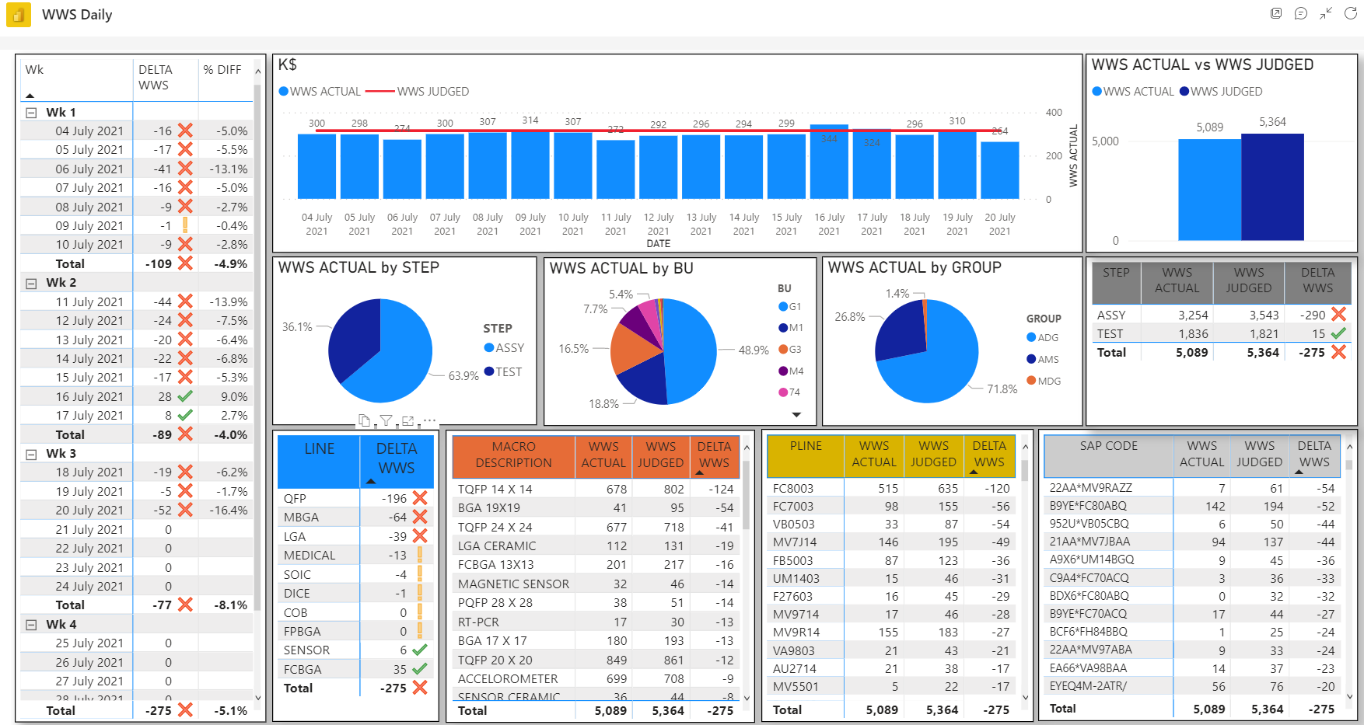
Mgt.Control Process automation – WWS results

Slide 2
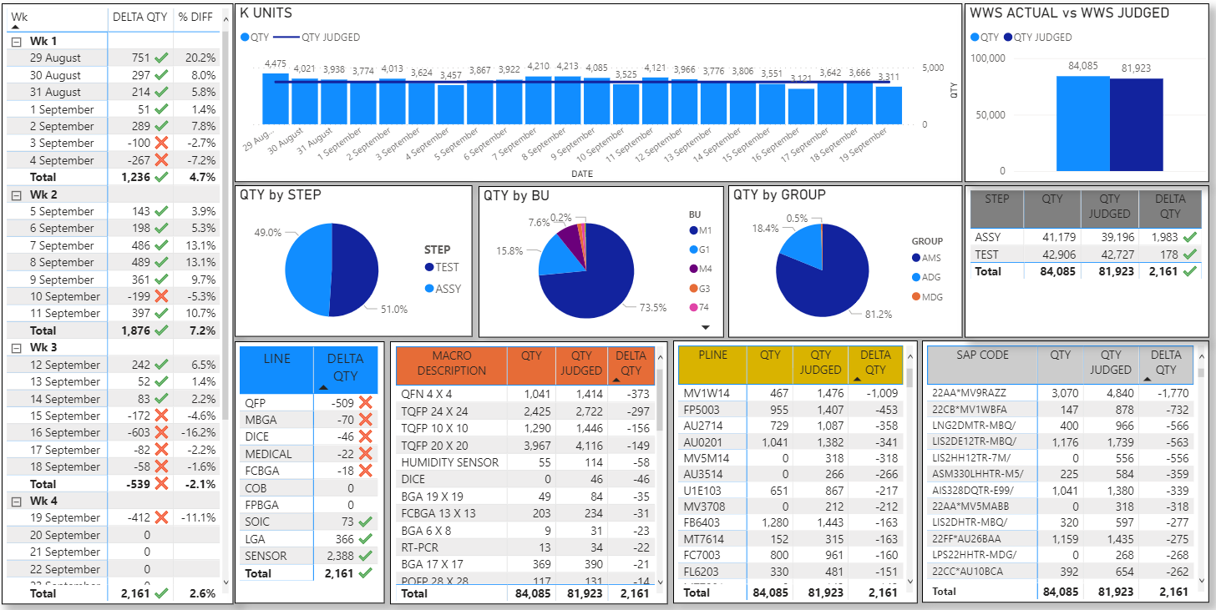
Mgt.Control Process automation – WWS results – QTY out

Slide 3
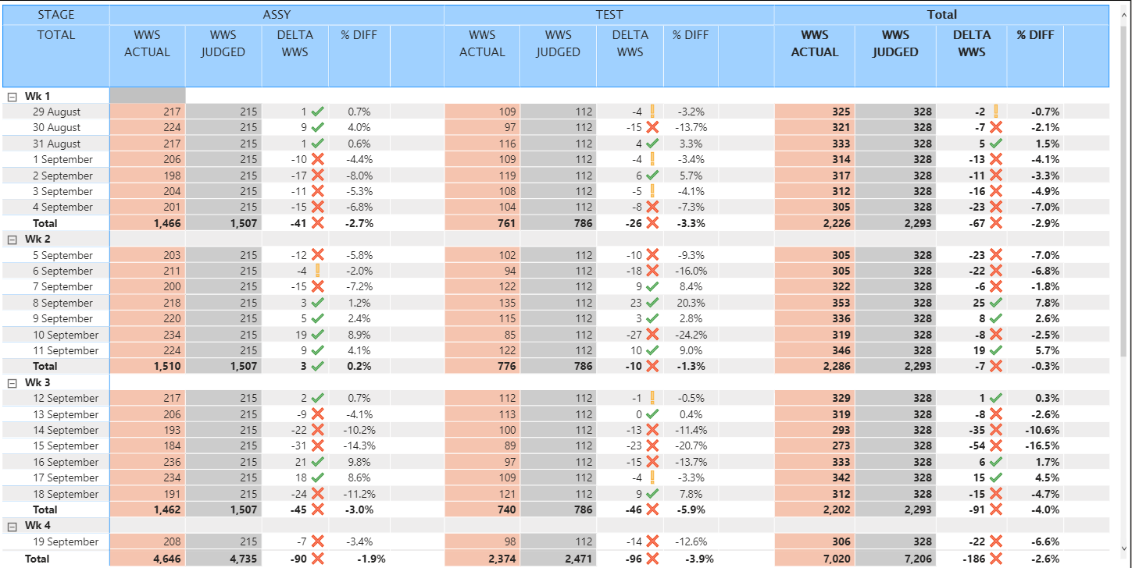
Mgt.Control Process automation – WWS results - WWS

Slide 4
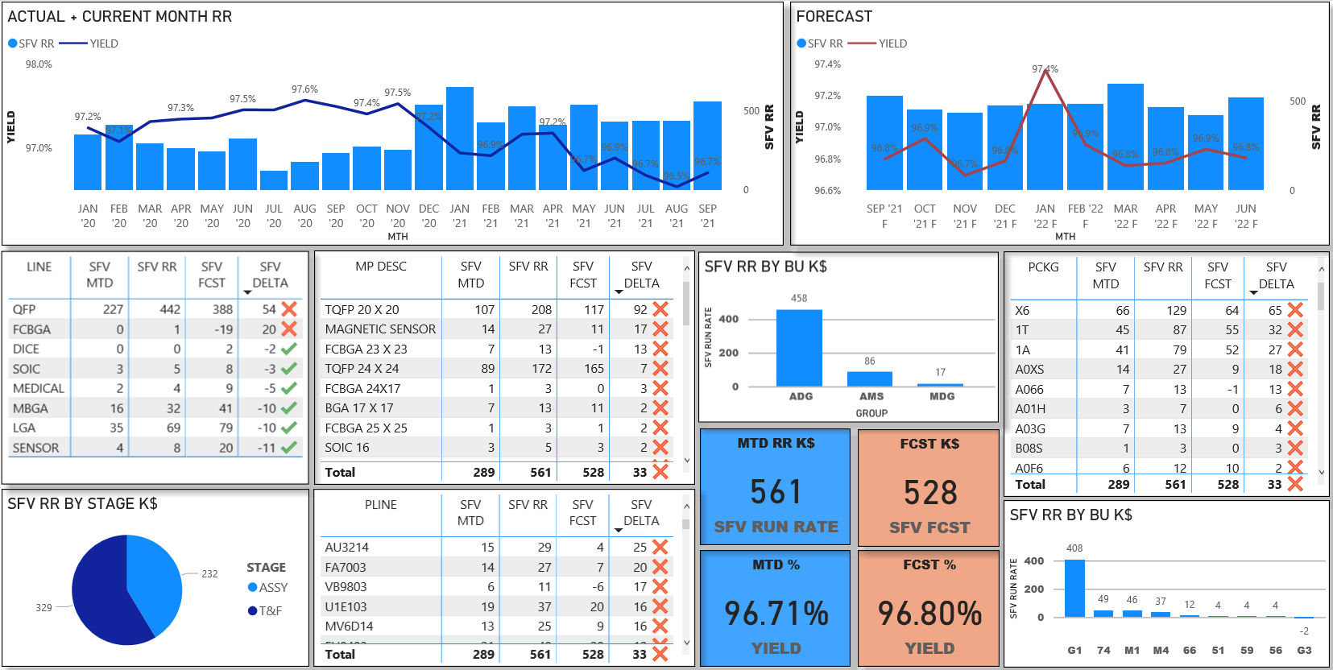
Mgt.Control Process automation – SFV results

